Slide 1
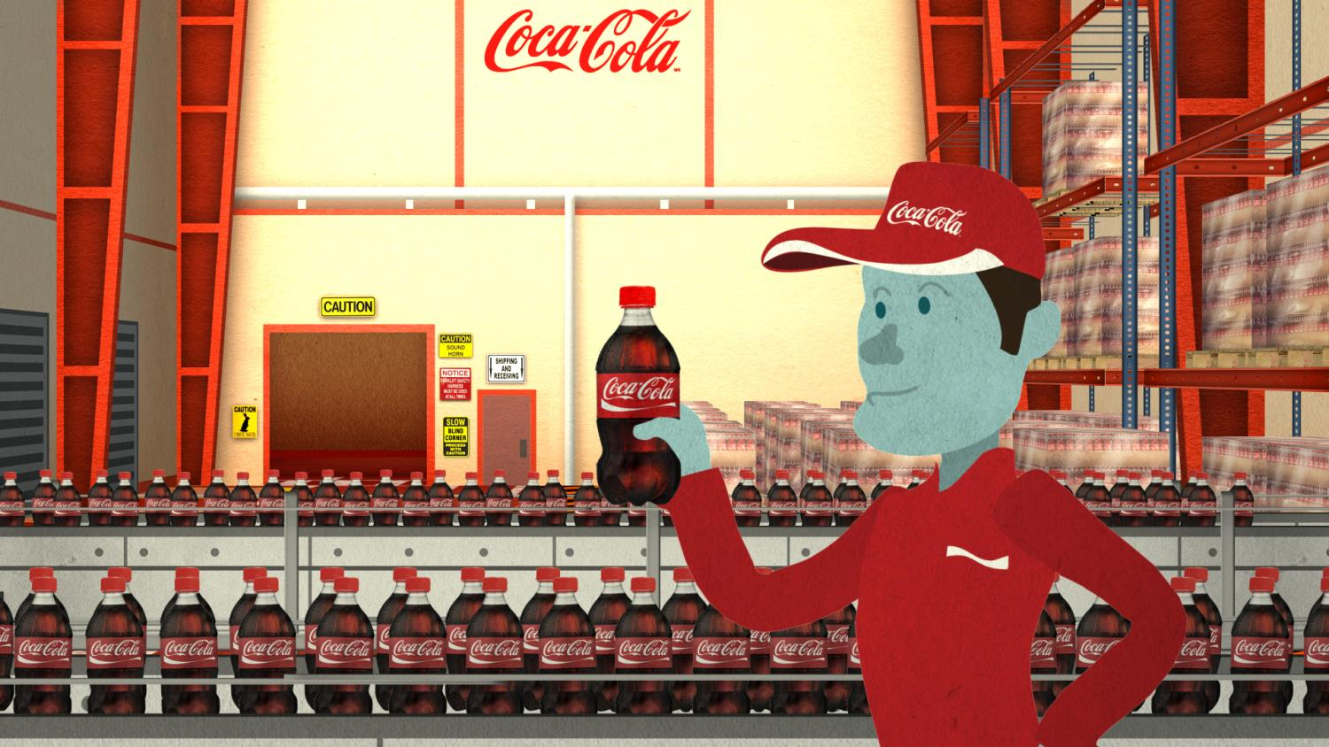
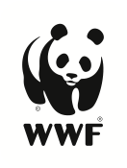
CLIMATE AMBASSADOR TRAINING
Module 2: THE BUSINESS CASE
in partnership with

Slide 2

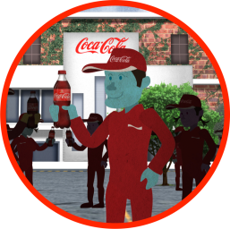
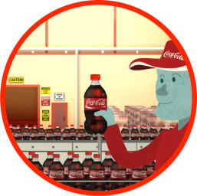
TRAINING AGENDA: LEADERS
CLIMATE AMBASSADORS
MODULE 1: INTRODUCTION
MODULE 2: BUSINESS CASE
• WHY WE ARE HERE
• GOALS • TRAINING OBJ. • DISCUSSION
• BUSINESS STRATEGY
• REVENUE • RISK
• REPUTATION
ME, WE, WORLD

Slide 3
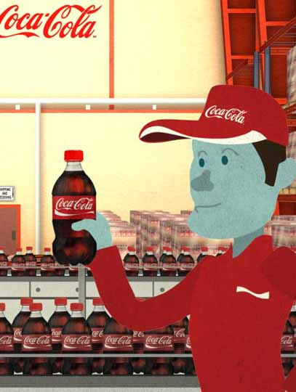
AGENDA
Seeing Business Opportunity
Scope of the Matter
Why: The Business Drivers

Slide 4
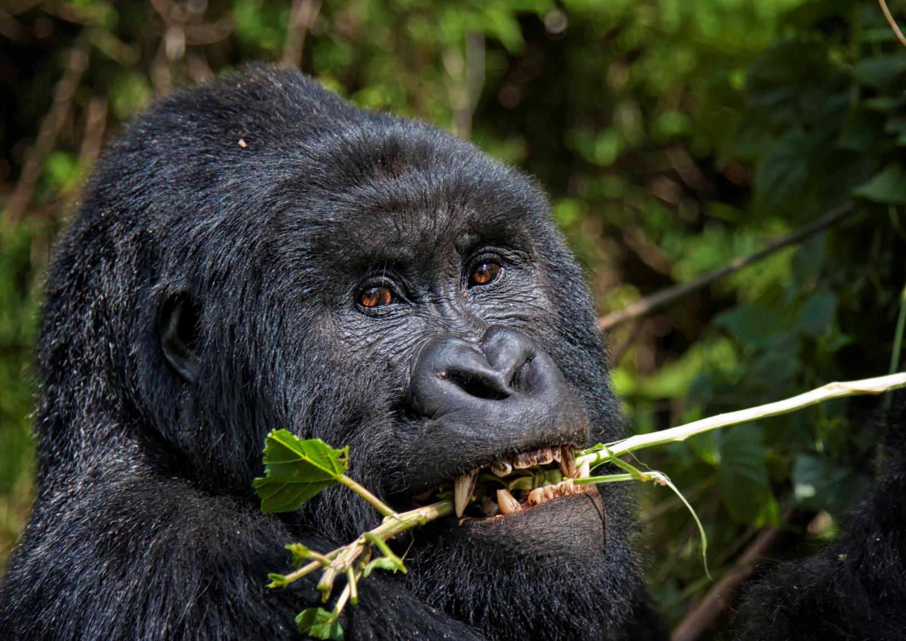
SEEING
THE BUSINESS OPPORTUNITY
Notes:

Imagine you are asked to watch a short video in which six people-three in white shirts and three in black shirts-pass basketballs around. While you watch, you must keep a silent count of the number of passes made by the people in white shirts. At some point, a gorilla strolls into the middle of the action, faces the camera and thumps its chest, and then leaves, spending nine seconds on screen. Would you see the gorilla? Almost everyone has the intuition that the answer is "yes, of course I would." How could something so obvious go completely unnoticed? But strikingly, many people fail to notice these unexpected objects, even though they are fully visible and distinctive. When this experiment was conducted at Harvard University several years ago, approximately half of the people who watched the video and counted the passes missed the gorilla. It was as though the gorilla were invisible.
When you ask someone to perform a challenging task, without realizing it, their attention narrows and blocks out other things. So, often, they literally can’t see even a huge, hairy gorilla that appears directly in front of them. This experiment reveals two things: that we are missing a lot of what goes on around us, and that we have no idea that we are missing so much.
It is the same with our jobs: we are so focused on getting things done that we forget to stop and look at the big picture. In this module, we stop to look at the big picture.

Slide 5

SEEING
THE BUSINESS OPPORTUNITY
Notes:
If interested:
The famous “invisible gorilla” test conducted by psychologists Dan Simons and Christopher Chabris in 1999 has now been similarly tested on radiologists to see if they would notice anything strange in scans to which they’re frequently exposed.
More than 24 experts were asked to evaluate five different scans and in the final scan was a dancing gorilla 48 times larger than the average potentially cancerous nodule they might be looking for. And many still missed it. 20 out of the 24 credentialed radiologists were unable to spot the gorilla.
The research by Harvard University post-doctoral fellow Trafton Drew, which will be published in the journal Psychological Science, even monitored eye movements of the radiologists and found they spent about 5.8 seconds looking the CT scan with the gorilla. Twelve of the radiologists who missed it actually looked right at it. According to the Association for Psychological Science’s Wray Herbert, the study raises a “disturbing possibility” that experts might have “perceptual blindness.”
This course sets out to help you better point out the gorillas to your colleagues and suppliers. The big opportunities we’re missing.

Slide 6

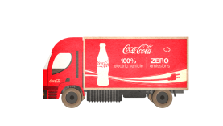
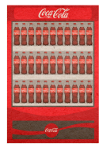



SCOPE OF THE MATTER
REDUCE CARBON FOOTPRINT (25%)
FOR THE “DRINK IN YOUR HAND”
INGREDIENTS
PACKAGING
MANUFACTURING
DISTRIBUTION
REFRIGERATION
13%
CO₂e
38%
CO₂e
9%
CO₂e
8%
CO₂e
32%
CO₂e
Baseline 2010*
Notes:
Let’s start by reviewing the scope of the challenge.
Our goal is to reduce the carbon of the drink in our hand by 25%. A reminder that this is a decrease on our GHG intensity, instead of a target on direct emissions.
In the past, we’ve been mostly focused on reducing carbon in our operations and factories. We’ve done good work there. For example, at KO a 10% GHG intensity reduction since 2004. As a result, now – you can see that manufacturing – accounts for around 9% of carbon for the KO operation. Without going in to deep calculations, it makes sense that working only in our manufacturing area will not get us to our goal (given our projected increase in volume).
To meet our goal, we need to look at our entire value chain, broadening our focus beyond the facility to look at risk, cost, waste and opportunity in ingredients, packaging, manufacturing, distribution, and refrigeration. Of course, these numbers will differ for all of our bottlers – based upon the product mix, the geography, and the other unique characteristics of your bottling facility, but the business opportunity spans far beyond the facility.
This requires quite a different business case. Of course, we know that bottlers are already engaging at climate reduction across their supply chain. And certainly, our peers and competitors are deeply engaged in the topic. Let’s take a look at one of their supply chains to have a different perspective on the scope.

Slide 7
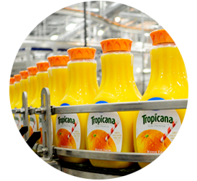
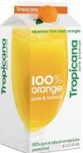
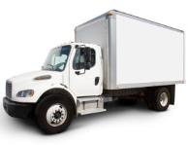
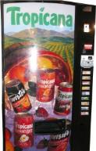
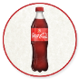
WHAT DOES THAT LOOK LIKE?
TROPICANA’S 64 OZ CARTON ORANGE JUICE
INGREDIENTS
PACKAGING
MANUFACTURING
DISTRIBUTION
CONSUMER USE
35%
FERTILIZER
15%
PACKAGING
24%
MANUFACTURING
22%
DISTRIBUTION
3%
CONSUMER USE
Notes:
Many companies around the globe are streamlining waste from their supply chains. Companies like Unilever, PepsiCo, Nestle are making big strides to meet the market demand.
Tropicana orange juice brand has engaged aggressively in this approach. In conjunction with Columbia University's Earth Institute, Tropicana estimated carbon footprint of its 64-ounce carton of Tropicana Pure Premium Orange Juice as 1.7 kilograms. Thirty-five percent (35%) of the carbon footprint came from growing the oranges—in particular, the manufacture of standard fertilizers used on crops. (Transportation and distribution accounted for another 22 percent, packaging accounts for 15 percent, and consumer use and disposal accounts for the remaining three percent.) Note that this life cycle analysis looked at consumer use and disposal – and the example we looked at before considers refrigeration.
The scope of Coca-Cola’s emissions strategy – has shifted.
We begin to see that we need a better understanding of the business – and of our supply chain – at the product level - to understand what opportunity we have.

Slide 8

THE SUGAR (beet) CARBON FOOTPRINT
AT BRITISH SUGAR
27%
SOIL EMISSIONS AND FERTILIZER
11%
DIESEL
4%
BEET TRANSPORT
57%
FUEL
1%
TRANSPORT
Notes:
We looked at orange juice. How about a different product. One with added sugar.
Supply chains are different for each product, of course. For colas, we’d want to look at sugar, citrus, and corn (syrup).
Take a look at British Sugar’s beet sugar supply chain. (And it’s important to note that our peers are actively engaged in streamlining supply chains.)
A broad comment before we move on to WHY we are doing this. Along this chain, or the Tropicana chain, or our own chain, we should start seeing these GHG numbers as cost and revenue opportunity. After all, it’s like money escaping into the atmosphere. Emissions are under-optimized energy; and energy is money.
At the same time, these examples help illustrate how very different the business opportunities might be with different suppliers. It is that mindset that you should have as we review the rest of the presentation.

Slide 9
BUSINESS CASE
REVENUE
RISK
REPUTATION
Notes:
As with everything in our business, we need a good business reason to proceed working along the climate change. So let’s take a look into why we are, and why we should. Now we’ll discuss the business drivers – the “why” behind what we are doing, in accordance with our Value Chain Model –

Revenue

Risk

Reputation.
Me, We, The World
EXERCISE: 5 minutes of discussion
Now we’ll review “the business case” in each of these areas, reviewing strong examples in each area. Of course, you would not use all of this evidence in one presentation. You would tailor your messages to the values of you audience – to talk about what’s important to them. Having practices in each area prepares you for many types of conversations.

Slide 10
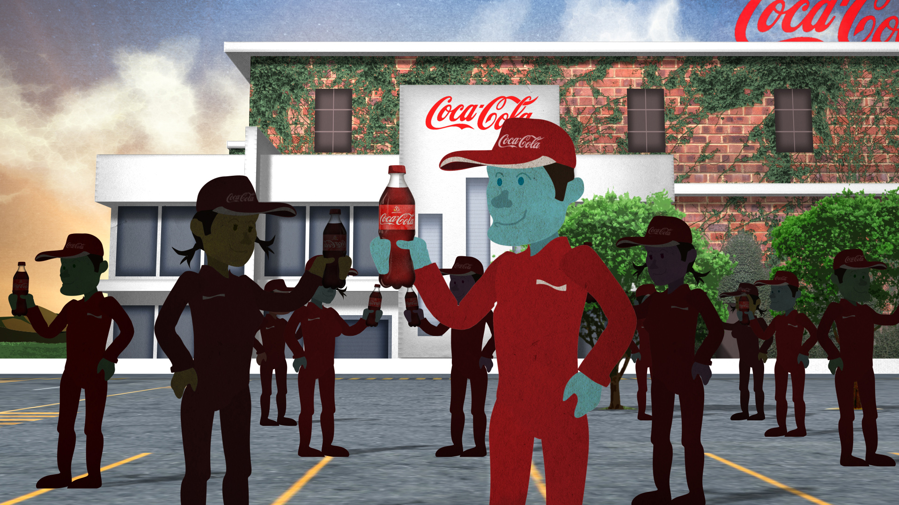
THE MARKET
REVENUE
CUSTOMER DEMAND
SHAREHOLDER EXPECTATIONS
CONSUMER DEMAND
Notes:
Coca-Cola has focused a lot on costs, so let’s start with the revenue side of the equation. The case for climate reduction because the market is pushing for it. We often hear that the markets are different in each country. True, but there are global trends. And we’ll start with one of the most powerful: our customers.

Slide 11

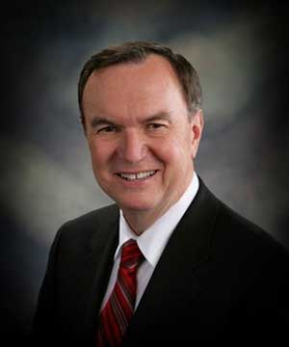
CUSTOMER DEMAND:
THE WALMART EFFECT
“By the end of 2017, Walmart will buy 70 percent of the goods it sells only from suppliers who use the Index to evaluate and share the sustainability of their products.”
— Mike Duke, CEO Walmart, October 2012 Beijing, China
Notes:
Our customers expect that we engage aggressively in climate action along our supply chain – at all of our bottlers.
Let’s take Walmart as an example.
In Feb 2010, Walmart announced a goal to eliminate 20.0 MMT CO2e of GHG emissions from its global supply chain by 12/2015
In Oct 2012 the CEO of Walmart, Mike Duke, said: “By the end of 2017, Walmart will buy 70 percent of the goods it sells only from suppliers who use the Index to evaluate and share the sustainability of their products.” Beijing, China
Wait, COKE IS their supply chain. They plan to cut emissions from us.
And this is not just a fancy example. It’s happening: In 2012 Walmart called upon a group of companies to work on fertilizers solutions to reduce climate impact. In our cohort are: Coke, Jack Daniels (Brown Forman), Smithfield, Kelloggs. The companies came to the table, and we all invested in this project because our customers expect us to reduce. THAT IS KNOWN AS THE WALMART EFFECT.
Walmart also just released the Fertilizer Optimization Kit, tools for their suppliers.
But it is not just Walmart: many of the largest customers are asking for us to reduce emissions. Tesco, for example, has a goal to reduce Supply Chain emissions by 30% and Mr. Kent committed to Tesco’s CEO that we would create a joint carbon reduction plan with them.
Where do WE go to do that? OUR supply chain.
ADDITIONAL NUMBERS FOR INSTRUCTORS, IF OF INTEREST
--In 6/2011, Walmart reported S1&S2 of 21.4 MMT CO2e and S3 of 42.8k MT CO2e GHG emissions to the Carbon Disclosure Project (CDP)
--Walmart estimates that 95% of its emissions are in its supply chain, so Walmart could conceivably be reporting at least an additional 428.0 MMT CO2e of GHGs for its Scope 3 supply chain emissions alone, not including all other Scope 3 categories

Slide 12
SHAREHOLDER EXPECTATIONS
405 of GLOBAL 500
REPORTING ON CARBON
81%
78%
48%
Report physical risk from climate change
Integrate carbon into business planning
Plan low-carbon products
Notes:
So, our customers are expecting us to act. We can see what they’re reporting as targets and how much of their goals. And we hear from them directly that they’ll be pushing us so they can achieve their own market promises.
Our shareholders and the financial markets are another important factor for WHY we need to act.
Our shareholders are increasingly expecting environmental performance. We’re being rated on it – and benchmarked against our peers. Integrating climate risk and opportunity as part of business strategy is essential.
In fact, all of the best performing consumer products companies are setting and engaging on ambitious commitments. At present: 405 of GLOBAL 500 REPORTING ON CARBON

-81% REPORT PHYSICAL RISK FROM CLIMATE CHANGE
-78% INTEGRATE CARBON INTO BUSINESS STRATEGY
-48% Plan revenue streams from low-carbon products (which means you need to anticipate threats of competitors low-carbon products and services)
Increasingly climate is seen as a competitive strategy. And we do not want to be left behind.

Slide 13
CONE CR RESPONSIBLIITY - 10COUNTRIES;10,000 CONSUMERS
CONSUMERS SAY IT IS IMPORTANT TO SUPPORT THE ENVIRONMENT
81%
Notes:
This global consumer movement surfaces in the 2011 Cone CR Opportunity Study, a 10-country survey. The survey was fielded in countries comprising approximately half the world’s population, including the United States, Canada, Brazil, the United Kingdom, Germany, France, Russia, China, India and Japan. The research is supplemented with insights from some of the world’s foremost thought leaders on corporate responsibility.
Key global findings indicate:

81% of consumers say companies have a responsibility to address key social and environmental issues beyond their local communities;
93% of consumers say companies must go beyond legal compliance to operate responsibly; and,
94% of consumers say companies must analyze and evolve their business practices to make their impact as positive as possible.

Slide 14
GREEN: BRANDS GLOBAL SURVEY – WPP
CONSUMERS ARE CONCERENED ABOUT ENERGY USE
↑
The number of consumers citing energy as an issue roses in all countries.
Notes:
One of the main reasons we don’t want to be left behind is the end consumer. And it’s not just the US and Europe any longer. The GREEN: BRANDS GLOBAL SURVEY by WPP (a market research agency) which covers Australia, Brazil, China, France, Germany, India, the U.S., and U.K. from April 2 – May 3, 2011, reports:
Consumers are increasingly concerned about environmental issues, particularly energy use. In most countries, concern about the state of the economy fell, while concern about the state of the environment grew. The number of consumers who cite energy use as an issue rose.

Consumers want to buy from green companies and plan to spend more on green products. Consistent with previous years, the majority of consumers across all countries say it is important to buy from environmentally-friendly companies. In developing countries, the majority of consumers say they plan to ―spend more‖ on green products and services.


Slide 15
GREEN: BRANDS GLOBAL SURVEY – WPP - AU, BR, CN, FR, DE, IN, US, UK
CONSUMERS WANT ENVIRONMENTAL PRODUCTS
>25%
Say labeling/packaging has the greatest impact on their likelihood to purchase green products.
Notes:

Packaging influences green purchasing. At least a quarter of consumers in all countries say that packaging has the greatest impact on their likelihood to purchase green products. Consumers rely heavily on certification marks to decide if a product is green.

Slide 16
NIELSEN, GLOBAL STUDY, 58 COUNTRIES, 29,000 REPONDENTS
CONSUMERS WILL SPEND MORE WITH COMPANIES THAT GIVE BACK
50%
Consumers ages 40-44, will pay more for products, up from 38% two years ago
Notes:
Recently: The Nielsen Global Survey on Corporate Social Responsibility surveyed more than 29,000 internet respondents in 58 countries. The percentage of consumers willing to pay more increased among both males and females and across all age groups, with respondents under age 30 most likely to say they would spend more for goods and services from companies that give back. Among consumers ages 40-44, 50% agree they would pay more, up from 38% two years ago.


Slide 17
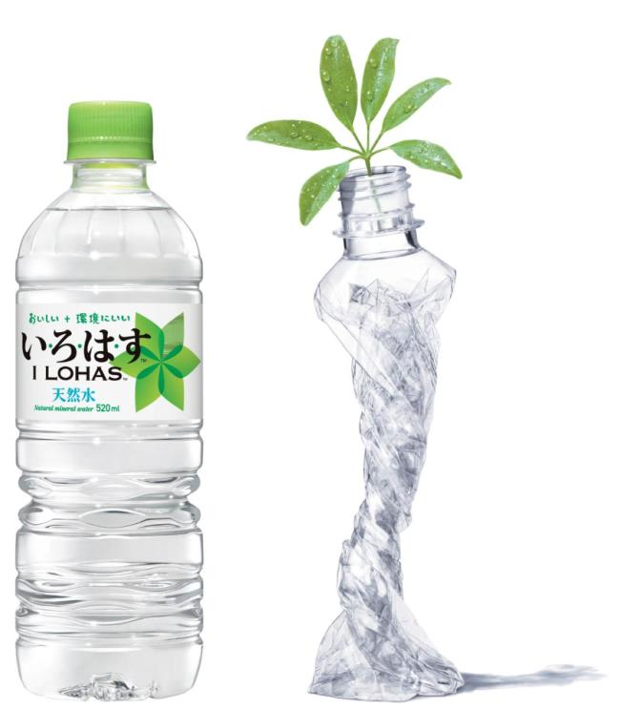
UPSIDE OF ENVIRONMENTAL PRODUCTS
iLOHAS BOTTLE
2 YEARS
Same water same price
FROM 5% TO 41.2% =
ONE BILLION $USD
Notes:
We can see the importance of packaging in our own business, through the PlantBottle™ example.

Coca-Cola projects the growth potential driven by PlantBottle™ -- for example, the Coke sparkling pilot in the US saw a 7 point increase in purchase intent. Peers and competitors are going to increasingly be looking to grow their environmental brands. And we’ll be doing the same. To do that, we need to be able to deliver the climate management that really make those products green.
At this point we are not accounting Revenue increase from the Carbon Reduction interventions, however in developing a larger business case, the growth of environmental products is important.
It’s clear that our customers, our shareholders, and our consumers are expecting us to act. (Not to mention our CEO.)

Slide 18
POP QUIZ
What is the largest organic juice brand in your market?
Who owns them? You or your competitor?
Notes:
POP QUIZ/DISCUSSION
What is the largest organic juice brand in your market?

Who owns them? You or your competitor?

Slide 19
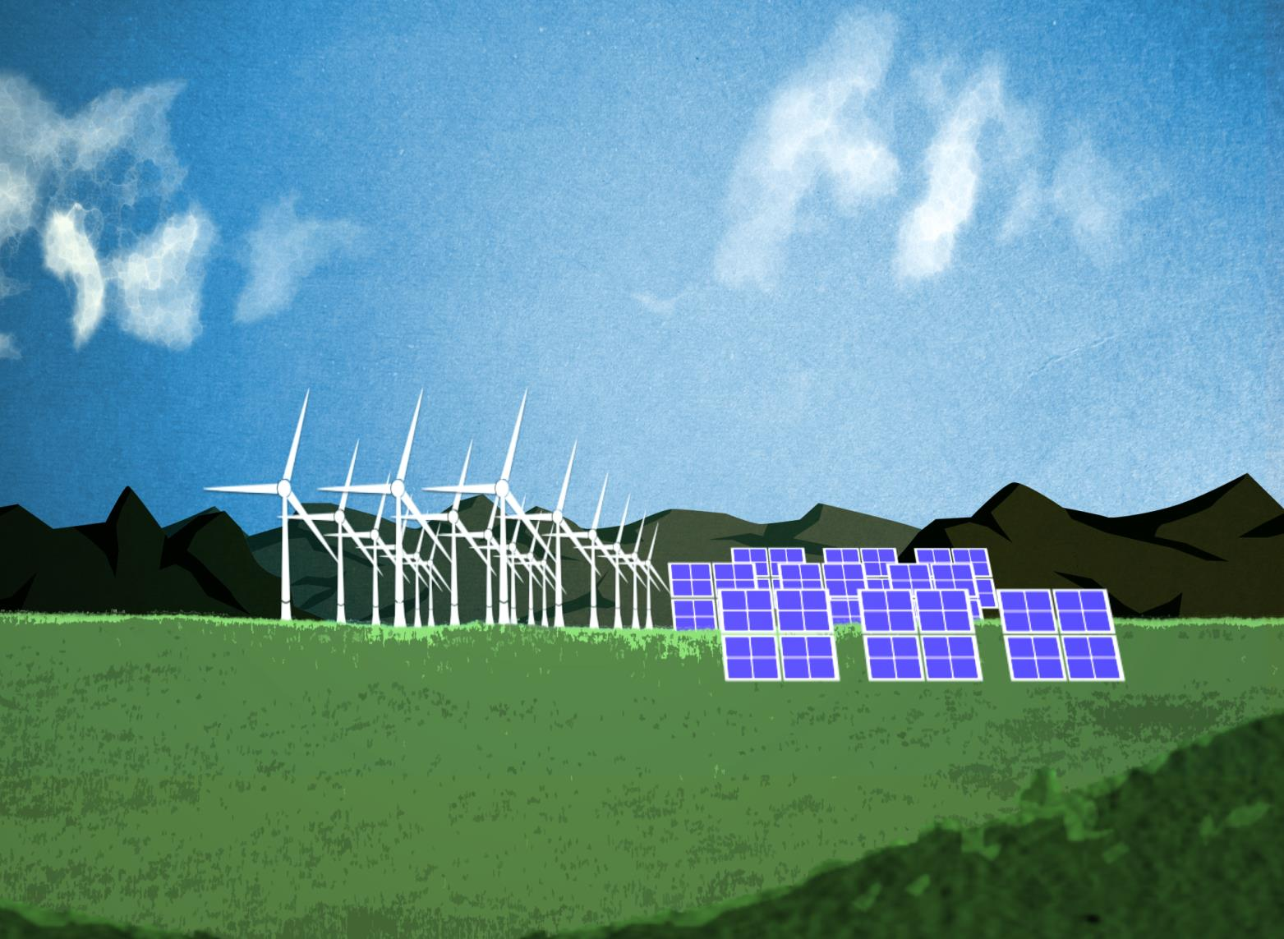
DIRECT OPERATIONAL
RISKS/COSTS
ENERGY COSTS
REGULATION
COST OF WEATHER EVENTS
SUPPLY DISRUPTION
Notes:
That’s the revenue side. Our customers want it, and shareholders and consumers expect it and are willing to put their money where their mouth is. Now look at why we need to do this from a risk and cost perspective.

Slide 20
THE GORILLA IS:
EMISSIONS ARE ENERGY
(ENERGY IS MONEY)
Notes:
Remember the gorilla? Well, emissions are energy. Plain and simple. It’s wasted money. So, wherever there are emissions, there’s optimizationto be had. And it’s your job to find out where that makes the most sense.
In engaging across the supply chain, we start to broader look at energy: ANYthing with emissions – from fertilizers to plastics to trucks to refrigeration emits. And emissions are money.
The energy efficiency opportunity accrued to customers for switching out cold drink equipment: 2.7Billion/year. Manufacturing would yield our system $200million/year. Fertilizer optimization yields another $900 million/year. That’s an important “Why”.

Slide 21

WORLD ENERGY OUTLOOK 2012
ENERGY DEMAND AND COSTS
↑33%
Demand for energy grows more than 33% globally by 2035.
Notes:
The cost of energy will increasingly be a concern for us. The WORLD ENERGY OUTLOOK 2012 reports that ENERGY DEMAND AND COSTS SURGE. That means more expensive fuel. And WAIT: more expensive commodities (ingredients!). Working along our value chain to reduce energy use is a cost management strategy we can’t afford to ignore.

-Demand for energy will grow 1/3 before 2035
-Water needs for energy production will grow at 2x the rate of energy demand
-Costs increase significantly

Slide 22
WORLD ENERGY OUTLOOK 2012
ENERGY DEMAND AND COSTS
2x
Water needs for energy production will grow 2x the rate of energy demands
Notes:

-Demand for energy will grow 1/3 before 2035
-Water needs for energy production will grow at 2x the rate of energy demand
-Costs increase significantly

Slide 23
WORLD ENERGY OUTLOOK 2012
ENERGY COSTS SURGE
15%+
Adjusted increase of 15% over record-prices, if production keeps up with demand
Notes:

-Costs increase significantly

Slide 24
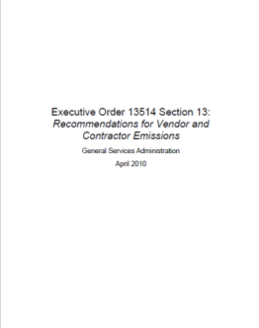
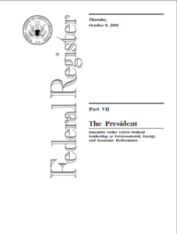
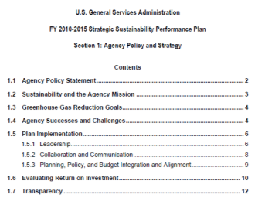
POTENTIAL AND CURRENT
REGULATION
-Carbon tax
-Cost of upgrading technology in response to regulation
-Regulations more likely in each country presenting risk and opportunity, like EO 13514, Section 13
Notes:
And, of course, there is regulation.

Some markets already experience regulation on their emissions; and for the rest of us, regulation is looming. There is the possibility of carbon tax, and other punitive regulations that can result in big costs (for upgrading technology in response to emissions, etc). But there is the opportunity side of regulations too: like EO 13514, Section 13 par of the US General Services Administration. In short, if you want to sell to the US government anywhere, you must be reporting.
QUESTION: What does this look like in your country?

Slide 25
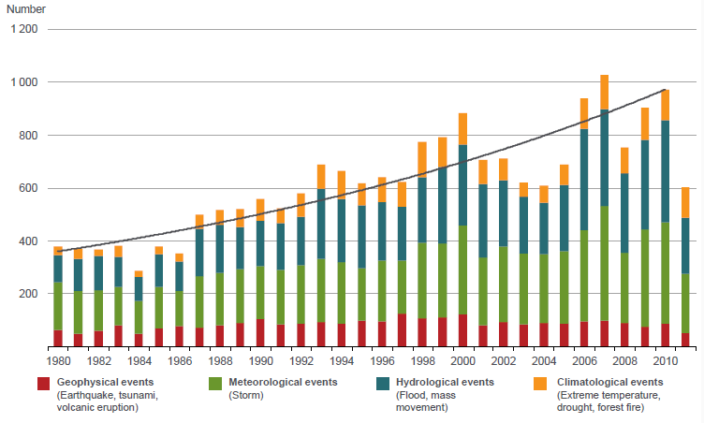
COSTS OF WEATHER EVENTS
ARE UPON US…
Graph copyrighted by and courtesy of: Munich RE and Munchener Ruckversicherungs-Gesellschaft, Geo Risks Research, NatCatSERVICE
Notes:
We can already see the changes are upon us. One of the world’s more substantial insurance/reinsurance firms MunichRE has one of the largest databases of adverse weather events. They’ve been tracking for 30 years. And what they show is a steady increase in hydrologic (floods, mass movement), represented in blue, and climatologic events (extreme temperature, droughts, and forest fires), represented in orange.
Don’t get excited by the lower graph after 2010. Focus on the orange and blue.
25

Slide 26
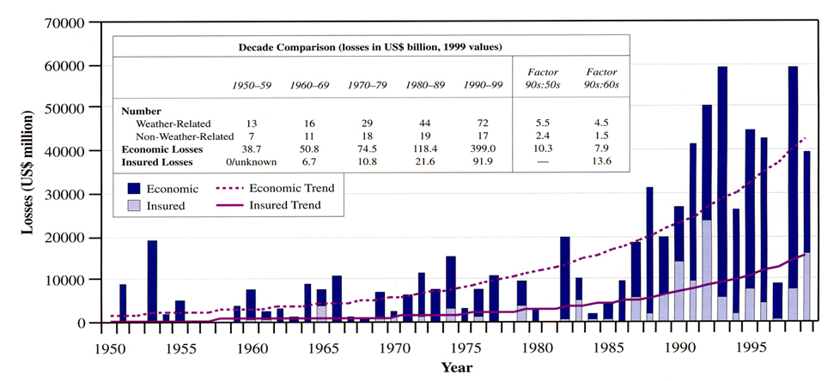
DIRECT IMPACTS TO BUSINESS
ARE VISIBLE ALREADY
Insurance & Reinsurance, Corporations, FEMA, OFDA, NGOs, Nation States, UN Agencies
Notes:
But that shouldn’t be a surprise to us.
The direct impacts of those climatological events have been seen in business already. Businesses have internalized these costs – in losses – without even taking note. As you can see here from the losses and costs to business from weather events even in the 90s. We see this in flooding, in bad weather in operations around the globe.
The costs are predicted to be much more disruptive to our businesses because of the dramatic nature of the expected change. In short, global warming means high insurance costs, more weather events that create loss.
26

Slide 27
2009-2010
CLIMATE RISK ASSESSEMENT
INDICATED SIGNIFICANT BUT MANAGEABLE RISK
1.6%
35M
50%
Cost increase to beverage producers
Additional PET costs due to climate change
Increase in maize prices due to climate change.
Notes:
The Climate Risk Assessment undertaken by the Company in 2009-2010 indicated significant, but manageable, risks from climate change.
1.6% price increase for beverage manufacturers (in costs)
$35MM additional PET cost in 2020 due to climate change
And that report did project significant hikes in supply costs. “Maize prices are predicted to rise by 50% by 2050 due to climate change…and US maize production is predicted to fall by 3% in the next 30 years.“ This prediction is entirely consistent with what we are experiencing in the USA now.

Slide 28
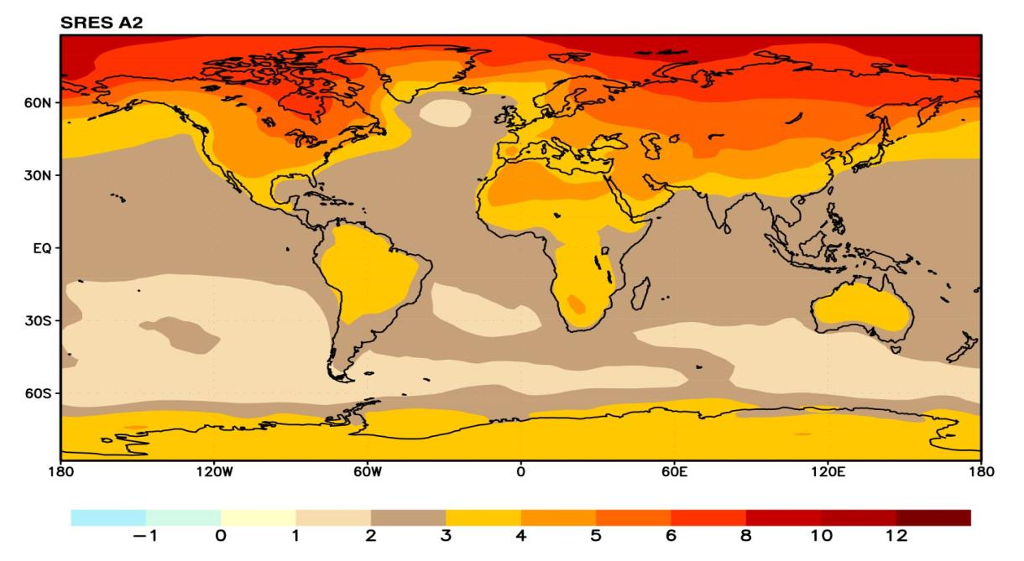
WHY SHOULD WE BE WORRIED?
AGRICULTURAL ZONES SHIFTING…
ANNUAL MEAN TEMPERATURE CHANGE, 2071 TO 2100 RELATIVE TO 1990
Notes:
So, why should be worried? For a number of reasons… Agriculturally, we’re going to see some big supply disruptions from shifting growth zones.
Here’s what SRES says:
EXERCISE: WHAT’S THE PREDICTED TEMPERATURE DIFFERENCE WHERE YOUR INGREDIENTS COME FROM?
This map is the science behind why Walmart is pushing us and we’re going to push our suppliers. We need to figure out how to stabilize our supplies at current cost. But we’ll leave that for later.

Slide 29

FLOODS PUT FARM INDUSTRY AT RISK
“A freak tornado and floods last month may be a harbinger of a troubled future for Brazilian farmers, who worry that climate change could severely disrupt production in one of the world's breadbaskets.
"Brazil is vulnerable. If we don't do anything, food production is at risk," says Eduardo Assad, an agronomist at the government's agriculture research institute, Embrapa.
At stake is a $250 billion farm industry.”
SUGAR SUPPLY DISRUPTION
Notes:
The system is already seeing Supply Disruptions from weather already. Changing growing seasons will result in significant crop risk, which can skyrocket the costs for commodities. As Reuters reported in Brazil….
 SUGAR SUPPLY DISRUPTION
ARTICLE TEXT
A freak tornado and floods last month may be a harbinger of a troubled future for Brazilian farmers, who worry that climate change could severely disrupt production in one of the world's breadbaskets. "Brazil is vulnerable. If we don't do anything, food production is at risk," says Eduardo Assad, an agronomist at the government's agriculture research institute, Embrapa. At stake is a $250 billion farm industry.

Slide 30
CITRUS SUPPLY DISRUPTION
“Citrus fruit production has declined by 1,000 tonnes in the district in the last two years. "In 2009-10, it was 22,184 tonnes while in 2010-11 it decreased to 21,704 tonnes," district horticulture authorities said.
"Climate change is one major factor affecting the fruit crop. We are facing problems on this count for the last eight to ten years. It's not raining in time because of which, plants are not getting proper nutrition and fruition is declining gradually," said Ramesh, an orange grower from Indora.”
Notes:
Or the times of India reports:
 CITRUS SUPPLY DISRUPTION
ARTICLE TEXT
“Citrus fruit production has declined by 1,000 tonnes in the district in the last two years. "In 2009-10, it was 22,184 tonnes while in 2010-11 it decreased to 21,704 tonnes," district horticulture authorities said.
"Climate change is one major factor affecting the fruit crop. We are facing problems on this count for the last eight to ten years. It's not raining in time because of which, plants are not getting proper nutrition and fruition is declining gradually," said Ramesh, an orange grower from Indora.”

Slide 31
HEAT COMPROMISES CROPS
“Federal scientists say this July was the hottest on record, smoking out even the sweltering temperatures set in the Dust Bowl in the 1930s. The National Oceanic and Atmospheric Administration reported Wednesday that the stretch from August 2011 through July this year was the warmest 12-month period the U.S. has experienced.”
CORN SUPPLY DISRUPTION
Notes:
Or The Huffington Post…. Supply risk is upon us.

CORN SUPPLY DISRUPTION
Supply disruption: It’s happening and we can only expect it to get worse.

Slide 32
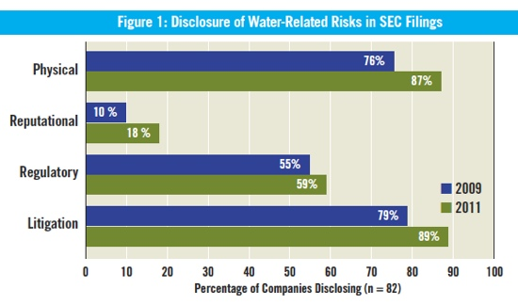
WATER RISK
INCREASING IN ALL INDUSTRIES…
Figure from CERES Clearing the Waters: A Review of Corporate Water Risk Disclosure in SEC Filings
Notes:
This is not a mere prediction. Companies are increasingly reporting water risk
27 percent of companies assessed in CERES Clearing the Waters: A Review of Corporate Water Risk Disclosure in SEC Filings made the between climate change and water risk in 2011, up from 10 percent in 2009, according to a report from Ceres. Those include Anheuser-Busch InBev, PepsiCo, KB Home, Alcoa and Intel
Companies disclosing water-related physical risks increased from 76 percent to 87 percent (see chart), according to the report. Oil and gas, and chemical companies’ reported exposure to physical water risks jumped to 31 percent and 45 percent, respectively. Additionally, the study found a 46 percent increase in the number of food companies reporting exposure to water-related risks.
Of the 11 food companies evaluated, Archer Daniels Midland, Bunge, PepsiCo and Smithfield were the ones with water-related supply chain risk disclosures that mentioned specific agricultural commodities or regions facing water risk, or discussed climate-change impacts on their supply chains, Ceres says.
32

Slide 33
SO WHAT?
SUPPLY DISRUPTIONS
WATER AVAILABILITY AT RISK
THAT SOUNDS EXPENSIVE.
Notes:
Or The Huffington Post…. Supply risk is upon us.

CORN SUPPLY DISRUPTION
Supply disruption: It’s happening and we can only expect it to get worse.

Slide 34

WHAT’S HAPPENED AT OUR PLANTS?
Notes:
DISCUSSION: Ask participants if they have seen changes from unusual disruptive weather events and climate trends. Unseasonal droughts? Floods not expected for the region, attributed to environmental changes? Supply disruption?

Slide 35
THE BUSINESS OPPORTUNITY
IT’S CLEAR
Notes:
The business opportunity is very clear.
Our customers are pushing us
Our shareholders expect it
Consumers are increasingly demanding our action
We need to act to prevent an untenable environment/losses
And we need to secure our supply

Slide 36
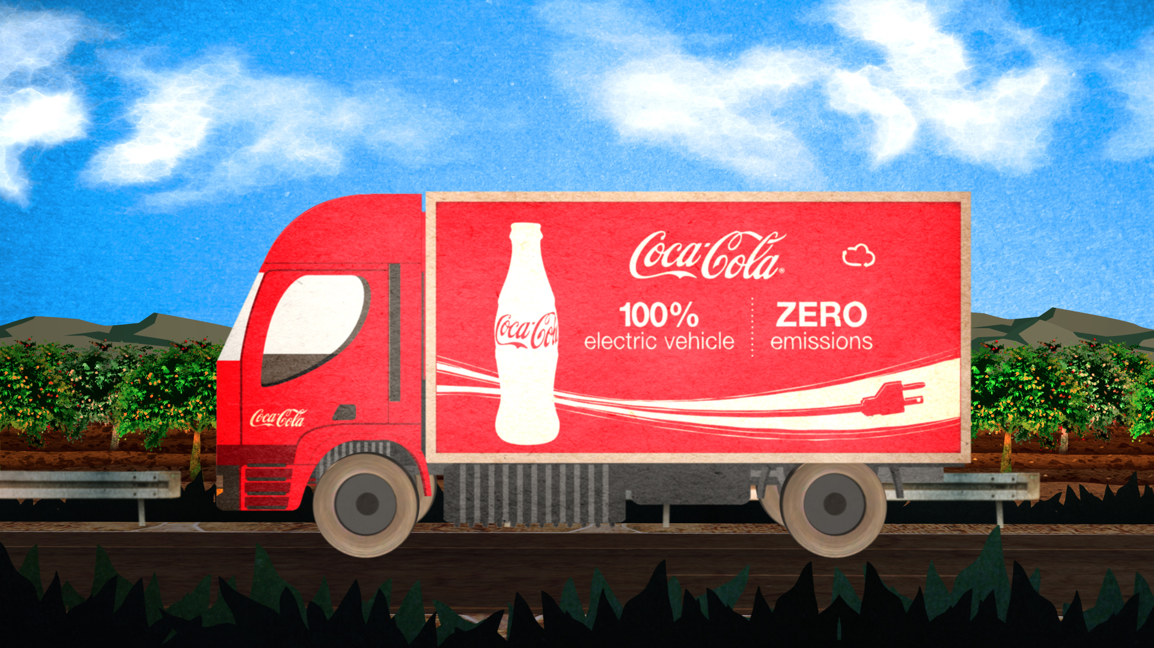
REPUTATION
LICENSE TO OPERATE
CORPORATE RESPONSIBILITY
Notes:
And it is also our responsibility. In order to maintain their license to operate, bottling companies need to be responsible stewards of the environment and positively contribute to the communities in which they operate. Working with suppliers, local nonprofits and stakeholders to build healthier communities to work, live, and play.

Slide 37


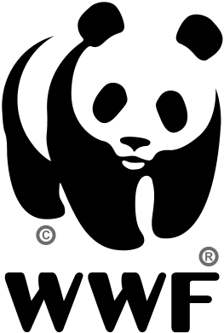
THE WORLD
©background image
Chris Martin Bahr/WWF-Canon
Notes:
But it is not just about business, it is also about Societal Impact, and our impact as a members of the community.
An important part of our World (Environment) commitment is our partnership with the World Wildlife Fund.
ASK:
How many people knew about the partnership before today?
What does the partnership do?
Through the global partnership Coca-Cola and WWF have committed to conserve and protect our freshwater resources. We are:
helping ensure healthy, resilient river basins in 11 key regions
measurably improving environmental performance across the company’s value chain
integrating the value of nature into public and private decision-making processes
convening influential partners to help solve shared global challenges
Engaging in climate reduction is an essential part of our initiative – to preserve our water, to serve our community.
It’s not just good business sense. It’s good corporate citizenship.
At that same time that we say it’s not about business, let’s talk about how our partnership with WWF was very good for business.
WWF has partnered with Coca-Cola to set climate goals and to deliver on performance in these areas. In the next module, you’ll hear about how Coca-Cola partnered with WWF to develop and launch the Top 10 Energy Savings Challenge, which should help Coca-Cola meet over 50% of its carbon goal, as well as how WWF works with Coca-Cola across all areas of the value chain to deliver real business value.

Slide 38
GOALS
OF ACTING
1
Meet buyer’s expectations and enhance competitive positioning.
2
Capitalize on opportunities for innovation and cost savings.
3
Manage risk/secure resources.
4
Protect the planet/corporate citizenship.
Notes:
We’ve heard the “why”. The goals of our engaging on climate action are:
Meet buyer’s expectations and enhance competitive positioning

Capitalize on opportunities for innovation and cost savings.

Manage risk/secure resources.

Protect the planet/corporate citizenship.

Slide 39
EXERCISE
SCENARIOS Talking with Internal Colleagues
Notes:
EXERCISE
Split into your respective groups.
You have 3 minutes to present to a group of your internal colleagues in Ingredient Procurement (within your Group) about the importance of looking for carbon opportunity in their sourcing. Your goal is to convince them it’s important to start working on reducing carbon impact along the supply chain. We are going to judge your presentations based upon an undisclosed criteria set, just like you would be judged in any business conversation.
In groups of 2-4, outline a 3-slide presentation. Before you do this, discuss:
What do you think would be most important to your Ingredient Procurement colleague (Revenue, Risk, or Reputation)? (Use the context at your Group.) Why?
Given their value (what’s most important to them), what would be most compelling messages to convince your colleague it was important to start thinking about this?
What’s your strongest piece of evidence?
Outline your 3-slide presentation
EXERCISE
After the exercise, one group will present in front of the room.
Discuss what groups did/said differently
Discuss what works/doesn’t work
Discuss what you would need to know before having this conversation

Slide 40
EXERCISE
What do you think would be most important to your Ingredient Procurement colleague (Revenue, Risk, or Reputation)? (Use the context at your Group.) Why?
Given their value (what’s most important to them), what would be most compelling messages to convince your colleague it was important to start thinking about this?
What’s your strongest piece of evidence?

Slide 41
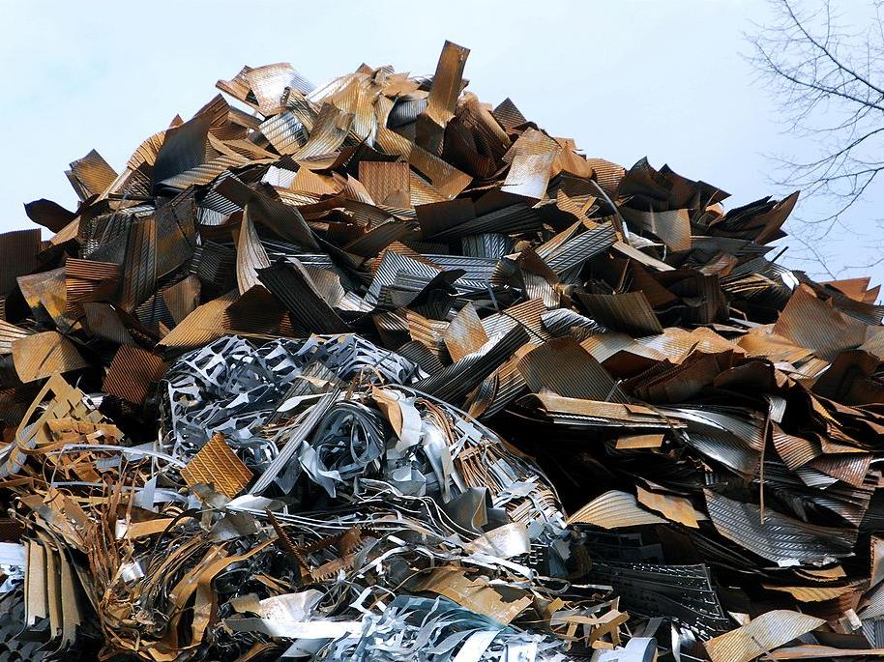
SO WHAT DOES IT ALL MEAN?
IDENTIFYING WASTE
ALSO KNOWN AS OPPORTUNITY
IN THE SUPPLY CHAIN
Photo credit: Wikimedia Commons
Notes:
It’s important to act, and we must be good messengers in our own organizations about why this is so important and how we can act. GHG Strategy cannot be separate from your strategic business plan. It is part of it, integrated throughout your planning.
Now we’ll look at what it means to act: in our next module we’ll look to identify waste. The cost savings and wasted opportunity (revenue) – in the supply chain. We’ll look at “the low hanging fruit” and the “not so low hanging fruit”. And we’ll see how your peers and competitors are taking these issues head-on.

Slide 42
RULES OF THE GAME
The team begins the game by selecting a category and monetary value (e.g. “Carbon Accounting for $100").
The host then reads the clue, after which and only after, any player on any team can raise their hand to answer. Anyone on the team may answer for their team.
Contestants must give the response in the form of a question (for example, “What is Climate Change”). Answers not given in the form of a question are considered incorrect.
Teams may discuss responses prior to raising their hands, but all conversation must stop when someone is called upon. The person who raises his/.her hand must be the same person that gives the response.
Answers not given in the form of a question are considered incorrect.
Teams may discuss responses prior to raising their hands, but all conversation must stop when someone is called upon. The person who raises his/.her hand must be the same person that gives the response.
A correct response earns the dollar value of the clue. The team that responds correctly will select the next clue. If the player gives an incorrect response or fails to answer in time (10 sec), that amount is deducted from the team’s score and another team may answer the clue. If no correct response is given, the host reads the correct response, and the team who originally chose the question maintains control of the game.

Slide 43
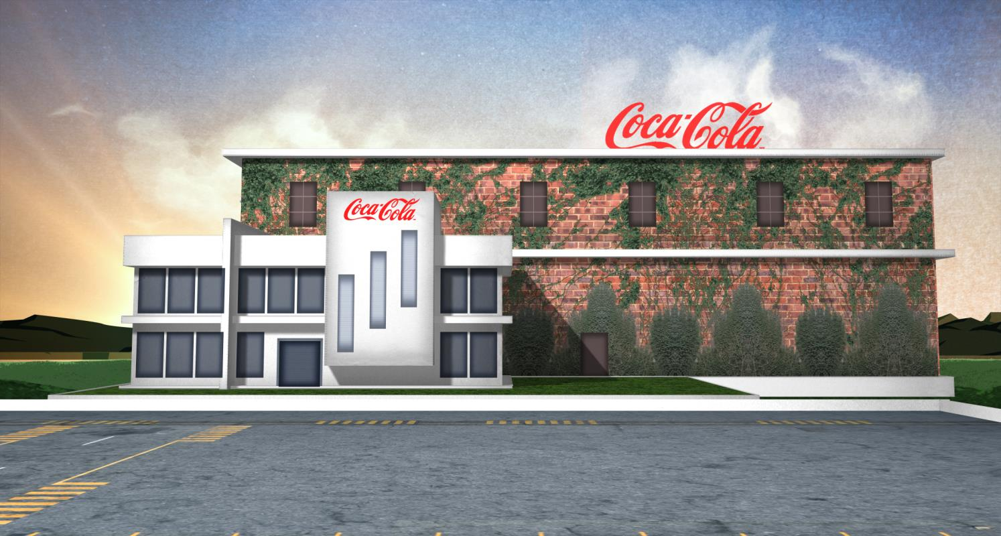

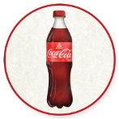
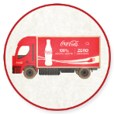
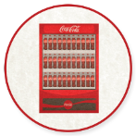

UP NEXT
Module 3: IN ACTION: OPPORTUNITIES ALONG THE VALUE CHAIN
in partnership with

